Slide 1
The Hebrew Bible

Slide 2
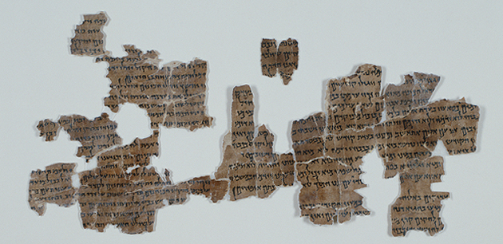
The Hebrew Bible
Pentateuch (Torah)- five books of Moses
Genesis
Exodus
Leviticus
Numbers
Deuteronomy
Debate over whether to treat the first chapters of the first book as a mythology or as history
Mythology: “narratives which go beyond what we know of real-life experience but have important metaphorical or spiritual meanings”
Greek muthos “myth” + Greek logia “the study of”

Slide 3
Genesis
Earliest history of the Hebrews
Traditionally written by Moses around 1300 B.C.
Covers time period between creation up to Hebrew escape from Egypt (beginning of time through 1300 B.C.)

Slide 4
Moses
Moses born around 1400 B.C. in Goshen (Lower Egypt)
great leader for the Hebrews, claimed to be chosen by God as the Hebrews’ guide to the promised land
Considered a prophet by all three Abrahamic religions: Islam, Judaism, and Christianity

Slide 5
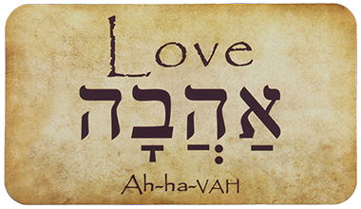
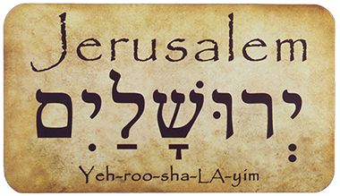
Hebrew Literature
Hebrews spoke a Semitic language
Appropriated the Aramaic Alphabet from the Persians who took it from the Assyrians
3rd Century B.C.
Elohim- semitic word for “god” is el or il
Al-ilah or allah Arabic for “god”

Slide 6
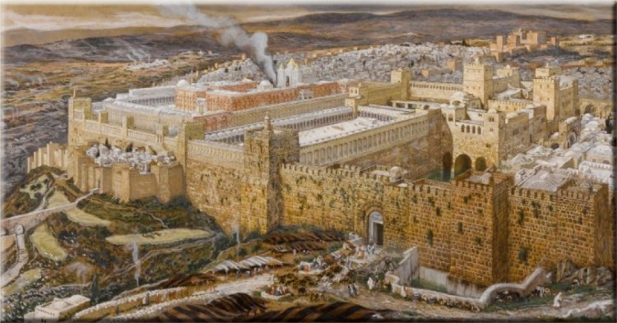
The Hebrews
Semi-nomadic, herders who settled in Canaan
Monotheism: the doctrine or belief that there is only one God
English mono “one” + Greek theos “god”

Slide 7
Parallelism
Big picture –> zoom into more detail
Repetition adding more detail each time
Frames a narrative
Repetition to bring attention to the text

Slide 8
http://www.jewishjournal.com/los_angeles/article/the_art_science_and_history_of_the_dead_sea_scrolls
http://newscenter.sdsu.edu/sdsu_newscenter/news_story.aspx?sid=73318
https://redeeminggod.com/genesis_1_5/
http://www.bible.ca/archeology/bible-archeology-exodus-route-goshen-red-sea.htm
https://en.wikipedia.org/wiki/Hebrew_language
http://rivkamalka.com/read-hebrew/
https://thewordinhebrew.com/shop/
https://en.wikipedia.org/wiki/Moses
http://www.newyorksocialdiary.com/travel/2008/jerusalems-old-city
http://www.realists.com/discovery/

