Slide 1
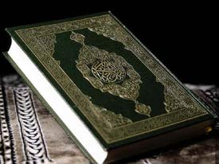
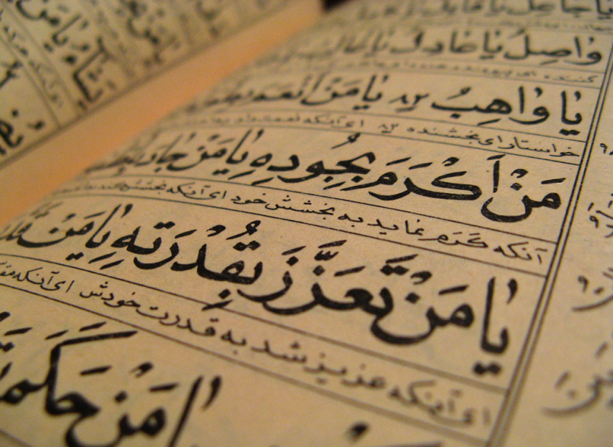
Intro. to the Koran
The Koran or Qur’an
Series of revelations received by the prophet Muhammed from A.D. 610-632 and written down
The Koran: the Recitation
Known as the “recited word of God/Allah” as opposed to the Christian “inspired word of God”

Slide 2
Earthly Koran is a copy of the divine Koran in paradise
The divine Koran is written on tablets of marble in golden writing, specifically Arabic
Like Allah, it was not created but has existed always.
Believed by Muslims to be God’s last revelation, sent to correct older revelations

Slide 3
Religion: Islam, known as the third of the “Abrahamic Religions” – religions which trace their ancestry back to the tribal leader Abraham. Christianity and Judaism are the others.
The revelations given to the Jews and Christians became perverted. Allah sent down the Koran to humanity to correct their mistakes.

Slide 4
Belief that it cannot be translated into other languages
Is literally God’s word, miraculous, and eternal. Translation is impossible.
Interpretations into other languages can be useful for teaching, but are not accepted by Muslims as the true Koran
Comparison: In Christianity the Bible is the Bible regardless of the language used

Slide 5
Muhammed/Mohammed received the revelations during the last 22 years of his life when the angel Gabriel would periodically visit him.
Considered to be the last of God’s prophets
Revelations recorded by his followers and compiled into one book after his death
Close ties to Christian/Jewish ideas
Story of Joseph in Egypt
Though not Son of God, Jesus (Isa) is a prophet
Moses (Musa) a key figure

Slide 6
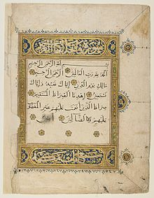
The Koran is organized into divisions known as Suras organized roughly by subject
First sura is known as the Exordium, and is put at the beginning of every Muslim speech, document, gravestone and prayer

Slide 7
“In the name of God, the Compassionate, the Merciful”

Slide 8
Think About
What is the nature of Allah?
What is the nature of man?
What is the telos of man?
What is the relationship between man and Allah?

Slide 9
REMEMBER
Ignore your brain knowledge. Listen and think exclusively about the text itself – not what you think you know.
This is a religious text people believe and find holy. Treat, speak, and think about these people and this book with the same respect you would want.

