Slide 1
Julius Caesar

Slide 2
Julius Caesar
English Drama- Tragedy
Written in 1599
Historical Context
Rome founded 753 B.C.
Rome becomes Republic in 509 B.C.
With a head of state and representatives
Caesar, Pompey, and Crassus form a triumvirate
Caesar defeats Pompey and declares himself dictator

Slide 3
William Shakespeare
Written by Shakespeare
Baptized on 26 April 1564 in Stratford upon Avon
Wealthy family
(Most likely) attended a free petty school and the King’s New School
Learned grammar and read the classics
By 1952, Shakespeare lived in London and worked as an actor and playwright
Acting company known as the Lord Chamberlain’s Men; renamed King’s Men

Slide 4
Shakespeare
IVDICIO PYLIVM, GENIO SOCRATEM, ARTE MARONEM,
TERRA TEGIT, POPVLVS MÆRET, OLYMPVS HABET
“A Nestor in judgement, a Socrates in genius, a Virgil in art
The earth holds him, the people morn him, Olympus holds him”
Nestor:
Socrates:
Virgil:

Slide 5
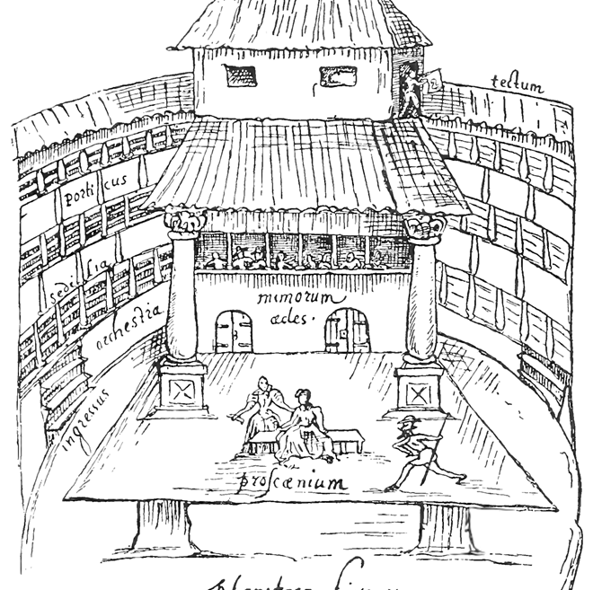
William Shakespeare
In 1599, the Globe Theater was built
Shakespeare was a part owner of the playhouse
The theatre was accessible to all classes; it cost a penny to stand in the courtyard
Held 3000 people
Open air playhouse with no roof, a raised stage, a pit, and three floors of seating

Slide 6
An Inside Peak
Photo Credit: Me!
Photo Credit: [The Globe] wikipedia retrieved on 2/1/2015 from wikimedia.org

Slide 7
Acting
Compared to many productions today, those originally put on in these theatres were very sparse.
Actors relied on their words and actions in order to convey scene to their audience
There were writers, actors, and owners
No understudies, conceptualizers, or directors
Boys were taken on as apprentices who played as young boys and all female roles
Because Shakespeare wrote for a company of actors he knew well, he “shaped his characterizations to the skills of his colleagues”.
Therefore, “he regularly repeats character types”: the fool, the “gullible old man”, and wily, “charismatic villain” (de Grazia & Wells, 2010).

Slide 8
PUNS!!
Pun: A joke “that results from multiple word meanings or rhyming sounds” (Allen et al, 2011)
Play on words
Two words that agree in the sound but differ in sense (homophones)
A word is said twice but its meaning changes the second time
A word is said once but two meanings are intended
Two words are said that sound similar but are not pure homophones

Slide 9
Why did Shakespeare use so many puns?

Slide 10
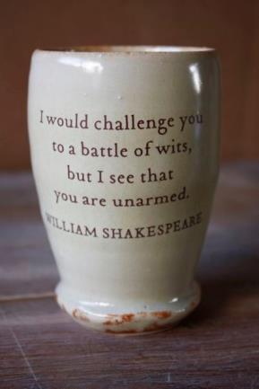
Elizabethan Reasoning
Today, puns are often considered one of the lowest forms of jokes.
However, in Elizabethan times, language and the ability to use wit to create word play was seen as a “divine gift” that distinguished “humanity from, and elevating it above, the rest of creation” (Hope, 2011).
As an aspect of Elizabethan culture, word play was “a sign of intelligence and social engagement” (Hope, 2011).
Individuals of society were expected to be able to and participate in word play in order to prove not just intelligence but social status.
Photo Credit: [Battle of Wits] pinteret retrieved on 2/14/2015 from pinterest

Slide 11
Allen, J., et al. (2008). McDougal Little Literature. Evanston, IL: McDougal
Little.
De Grazia, M., & Wells, S. (2010). The New Cambridge Companion to Shakespeare.
Cambridge, UK: Cambridge University Press.
Hope, J. (2010). The New Cambridge Companion to Shakespeare.
Cambridge, UK: Cambridge University Press.
Photo Credit: [Shakespeare] wikimedia retrieved on 2/1/2015 from wikipedia.org
Photo Credit: [Holy Trinity Church] geograph retrieved on 2/1/2015 from geograph.org.uk
Photo Credit: [The Swan Playhouse] wikimedia retrieved on 2/1/2015 from wikipedia.org.
Photo Credit: [Door Handles] Pinterest retrieved on 3/3/2015 from pinterest.com
Photo Credit: [A Rest] pinterest retrieved on 2/14/2015 from pinterest.

