Slide 1
Poetry

Slide 2
What is poetry?
A language of images and music
“Hope” is the thing with feathers - That perches in the soul - And sings the tune without the words - And never stops - at all -
And sweetest - in the Gale - is heard - And sore must be the storm - That could abash the little Bird That kept so many warm -
I’ve heard it in the chillest land - And on the strangest Sea - Yet - never - in Extremity, It asked a crumb - of me.

Slide 3
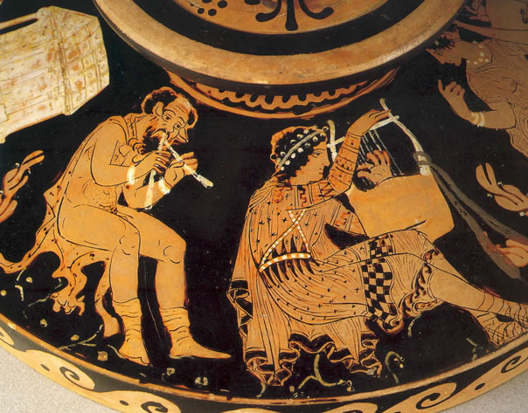
Why poetry
The highest from of writing and thinking
Conveys what simple words cannot
In Ancient Greece, poetry and philosophy were the highest vocations to pursue

Slide 4
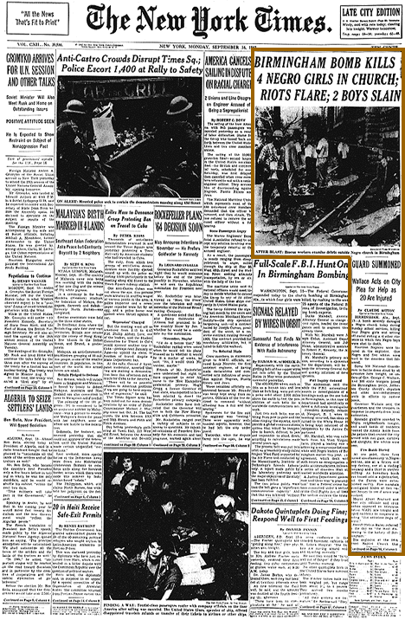
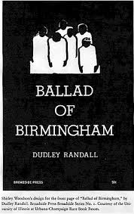
Why Poetry
News Article
Poem

Slide 5
How to read poetry
Read out loud
Re-read
Re-re-read
Memorize
Recite
Go away for a year or so and then read again and again and again
What does this say about poetry?

Slide 6
Syllables
Hearing/Counting Syllables
Haiku
5-7-5 syllables
An old silent pond...
A frog jumps into the pond,
splash! Silence again.

Slide 7
What we might have shared I'll never know - for you lie cold and still... below.

Slide 8
Haiku on getting out of bed
No no no no no
No no no no no no no
No no no no fine

Slide 9
Assignment
Write your own Haikus
Write 3 Haikus
MLA header
TYPED
Center each poem in the middle of the paper
First haiku must be about heroism
Second haiku must be about time
Third haiku topic is your choice

Slide 10
Example
Ms. Cooney
Ms. Cooney
Period 4
1/23
Haiku 1heroism
Haiku 2 time
Haiku 3 free choice

Slide 11
Rhyme
Full Rhyme
Cat
Green
Plot
Slant Rhyme
Visual or close in sound
Eye/symmetry
Death/earth
Near/bear

Slide 12
Rhyme Scheme
Combination of letters to trace the pattern of the rhymes.
HOW TO:
Listen to the sound of the last word of a line
Label this line A
Listen to the sound of the last word of the next line
If it rhymes label the line A, if it doesn’t, label the line B.

Slide 13
Meter
In the English Language, some syllables are accented some are not.
Carter
Kincade
Michael
Logan
Kimberly
Emma
Jacob
Chloe
Ethan
Accent = Stress
Unaccented = Breve

Slide 14
Practice
Gerogie Porgie, puddin’ and pie
Kissed the girls and made them cry.
When the boys came out to play,
Gorgie Portgie ran away

Slide 15
Meter
Combinations of stresses and breves are called feet.
5 kinds of feet:
Iambic – Breve Stress
Trochaic – Stress Breve
Anapestic – Breve Breve Stress
Dactylic – Stress Breve Breve
Spondee – Stress

Slide 16
Meter - Iamb
Most common combination of syllables in English Poetry
Breve Stress
Afraid
Oppose
Delight
Correct

Slide 17
Feet
Poetry is classified according to the kind of feet and number of feet per line
Number of Feet per line
1. Momometer
2. Dimeter
3. Trimeter
4. Tetrameter
5. Pentameter
6. Hexameter
7. Heptameter
8. Octameter

Slide 18
Scanning a Poem
3 Questions to answer to scan a poem
What type of feet predominantly make up the poem?
How many feet are there in the line?
What is the rhyme scheme?

Slide 19
How to Scan
Read the lines OUTLOUD a couple of times until you can feel or sense the rhythm (pound it out if you need to)
Mark the accented syllables with a stress
Mark the unaccented with a breve and insert foot boundaries
ID the predominate foot type and the number of feet per line
Label the rhyme scheme of the first stanza

Slide 20
Practice
The raging rocks
And shiv’ring shock
Shall break the locks
Of prison gates

Slide 21
Assignment
Complete the Iamb Scansion page – front and back

