Slide 1
Lesson 54
Representing Solids

Slide 2
Perspective Drawing – A drawing where non-vertical parallel lines appear to meet at a point called a vanishing point.
Example: If you look straight down a highway, it appears that the edges of the highway eventually come together at a vanishing point, like point A in the diagram.
Horizon - The horizontal line that contains the vanishing point(s) in a perspective drawing.
One-Point Perspective - A drawing with just one vanishing point.

Slide 3
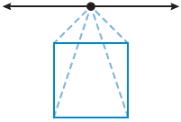
Example 1 Drawing in One-Point Perspective
Draw a rectangular prism in one-point perspective. Use a pencil with an eraser.
SOLUTION
Step 1: Draw a square and a horizontal line above it representing the horizon. Mark a vanishing point on the horizon.
Step 2: Draw a dashed line from the vanishing point to each of the four corners of the square.

Slide 4
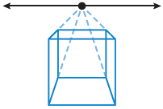
Example 1 Drawing in One-Point Perspective
Draw a rectangular prism in one-point perspective. Use a pencil with an eraser.
SOLUTION
Step 3: Using the dashed lines drawn in Step 2, draw the sides of a smaller square.

Slide 5
Example 1 Drawing in One-Point Perspective
Draw a rectangular prism in one-point perspective. Use a pencil with an eraser.
SOLUTION
Step 4: Connect the two squares and erase the reference lines and the horizon that are located behind the prism.
This prism is drawn from a one-point perspective.

Slide 6
A drawing with two vanishing points is said to have two-point perspective. Look at the following example to see how a drawing can be made from a two-point perspective.

Slide 7
Example 2 Drawing in Two-Point Perspective
Draw a rectangular prism in two-point perspective in which the vanishing points are above the prism.
SOLUTION
Step 1: Draw a horizontal line that represents the horizon. Place two vanishing points on the horizon. Draw a vertical line segment below the horizontal line and between the two vanishing points, representing the front edge of the prism.

Slide 8
Example 2 Drawing in Two-Point Perspective
Draw a rectangular prism in two-point perspective in which the vanishing points are above the prism.
SOLUTION
Step 2: Draw dashed lines from each vanishing point to the top and bottom of the vertical line as shown.

Slide 9
Example 2 Drawing in Two-Point Perspective
Draw a rectangular prism in two-point perspective in which the vanishing points are above the prism.
SOLUTION
Step 3: Draw vertical segments between the dashed lines from Step 2 as shown and draw segments to connect them to the first segment.

Slide 10
Example 2 Drawing in Two-Point Perspective
Draw a rectangular prism in two-point perspective in which the vanishing points are above the prism.
SOLUTION
Step 4: Draw dashed perspective lines from the segments drawn in Step 3 to each of the vanishing points as shown.

Slide 11
Example 2 Drawing in Two-Point Perspective
Draw a rectangular prism in two-point perspective in which the vanishing points are above the prism.
SOLUTION
Step 5: Draw a dashed vertical line between the two intersections of the perspective lines just drawn. Sketch the segments that make the top of the prism.

Slide 12
Example 2 Drawing in Two-Point Perspective
Draw a rectangular prism in two-point perspective in which the vanishing points are above the prism.
SOLUTION
Step 6: Erase the horizon line and the dashed perspective lines. Keep the dashed lines inside the prism that represent the edges that are hidden.
This prism is drawn from a two-point perspective.

Slide 13
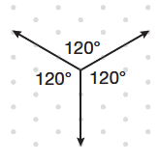
An isometric drawing is a way of drawing a three-dimensional figure using isometric dot paper, which has equally spaced dots in a repeating triangular pattern. The drawings can be made by using three axes that intersect to form 120° angles, as shown in the diagram.

Slide 14
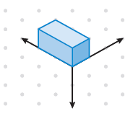
Example 3 Creating Isometric Drawings
Create an isometric drawing of a rectangular prism.
SOLUTION
Draw the three axes on the isometric dot paper as shown above. Use this vertex as the bottom corner of the prism. Draw the box so that the edges of the prism run parallel to the three axes. Shading the top, front, and side of the prism will add the perception of depth.

Slide 15
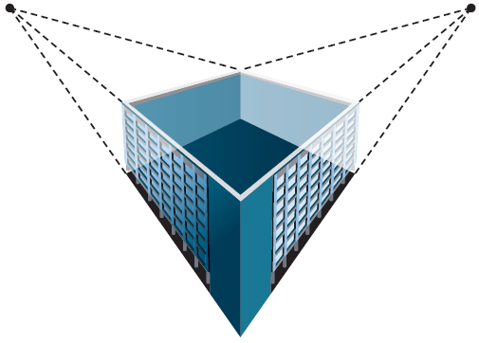
Example 4 Application: Drafting
An architecture firm is planning to construct a rectangular building on a corner lot. The client would like a drawing that shows the building as though someone is looking at it from one edge. Should the drawing be from a one-point or two-point perspective? Make a sketch of what the drawing should look like.
SOLUTION
Since the front of the drawing will be an edge of the building, a two-point perspective drawing is appropriate. The diagram shows a completed view of the building.

Slide 16
You Try!!!!
a.Draw a rectangular prism in one-point perspective in which the vanishing point is to the left of the square.
b.Draw a cube in two-point perspective with the vanishing points and horizon below the vertical line.
c. Make an isometric drawing of a triangular prism.
d.Drafting Morgan wants to make a wooden bookshelf with two shelves. The bookshelf will be 1 meter wide, 1 meter deep, and 1.5 meters tall. To decide how much wood to buy, Morgan will draw his plans for the bookshelf. Should the drawing be from a one-point or two-point perspective? Sketch what Morgan’s drawing should look like.

Slide 17
Assignment
Page 358
Lesson 54# 1, 2, 4, 6, 8-11, 13, 15,18,19, 21, 24, 28

