Slide 1
Prepositions

Slide 2
What is a Preposition
A word that relates a noun or pronoun to the rest of the sentence; that noun/pronoun we call object of the preposition
I walked ____ the door.

Slide 3
Prepositions
Allow for spatial possibilities
Through
Into
Under
Over
On
Out
Express concepts of time and condition
During
Before
Despite

Slide 4
Categories of Prepositions
Every prepositional phrase acts as either an adjective or an adverb.
They follow the same rules/questions as adverbs and adjectives
When we have the pattern subject, prepositional phrase, verb, the prep phrase is almost always an adjective modifying the subject

Slide 5
Identifying
Prepositions come in phrases, they do not occur by themselves.

Slide 6
About
Above
Across
After
Against
Along
Amid
Among
Around
As
At
Atop
Because of
Before
Behind
Below
Beneath
Beside
Between
Beyond
But (when means except)
By
Concerning
Despite
Down
During
Except
For (when not meaning because)
From
In, inside
Into
Like
Near
Of
Off
On, onto
Out, out of, outside
Over
Past
Since
Through
Throughout
To
Toward
Under, underneath
Until
Up
Upon
With
Within
Without

Slide 7
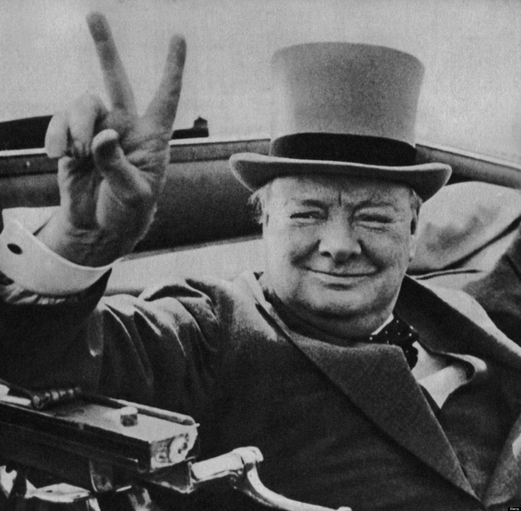
RULE OF PREPOSITIONS
Never end a sentence with a preposition!
“Ending a sentence with a preposition is something up with which I will not put!”

