Slide 1
The Iliad

Slide 2
The Iliad
Epic poem
Oral tradition
Written 760-710 B.C.
*One of the oldest stories in Western literature
Tells the story of the siege of the city Troy (Ilium)
In media res

Slide 4
Authorship
Traditionally written by Homer
Probably written by many men sometime between 900 and 700 B.C.
Homer
Blind poet
Lived somewhere in Asia Minor (near Troy)

Slide 5
Oral Poetry
Epic
Greek epos “saying, line of poetry”
Meter is dactylic hexameter (one long + one long or two short syllables per meter)
Six metrical feet
Oral poetry is formulaic because it makes memorization easier

Slide 6
Judgement of Paris
Who is the fairest woman? Aphrodite, Hera, or Athena?
Athena offered wisdom and skill in war
Aphrodite offered the world’s most beautiful woman as wife
Hera offered to make him king of Europe and Asia

Slide 7
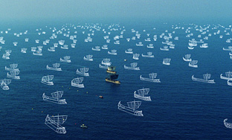
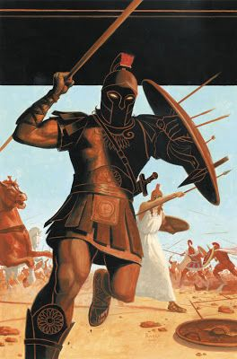
The Beauty That Launched A Thousand Ships

Slide 8
Themes
Kleos – Fame/glory
Heroism
Destructiveness of Rage

Slide 9
Epic Poetry
Lengthy narrative poem
Serious subject
Medias Res: beginning a story by plunging into the middle of the action
Latin In Medias Res “in the midst of things”
Writing style of lofty elevated
Invocation of the muse
The hero
Is of national or even cosmic importance
Embodies the values of the civilization
Encounters gods and monsters
Shows great valor during heroic deeds or events; superhuman courage
Trip to the underworld
Often significant to a culture or nation

Slide 11
Rage:
Sing; Goddess, Achilles’ rage,
Black and murderous, that cost the Greeks
Incalculable pain, pitched countless souls
Of heroes into Hades’ dark,
And left their bodies to rot as feasts
For dogs and birds, as Zeus’ will was done.
Begin with the clash between Agamemnon—
The Greek warlord— and godlike Achilles
The Invocation

Slide 12
http://shadowofthelion.com/cities-of-alexanders-world-troy-ilium/
https://en.wikipedia.org/wiki/Troy
http://www.mlahanas.de/Greeks/Live/Writer/Images/blueseahomermap.gif
https://en.wikipedia.org/wiki/Homer
http://www.ancient.eu/article/895/
http://www.theoi.com/Gallery/K4.5.html
https://paolorivera.blogspot.com/2007/10/helen-of-troy.html
http://www.today.com/style#386580
http://www.fanpop.com/clubs/katie-mcgrath/images/23640086/title/katie-mcgrath-helen-troy-fanart
http://www.cgsociety.org/index.php/CGSFeatures/FeaturePrintable/the_cg_vfx_of_troy_-_part_1
https://en.wikipedia.org/wiki/Iliad

